Slide 1
FACING INTERVIEW
Is a conversation between two people (the interviewer and the interviewee) where questions are asked by the interviewer to obtain information from the interviewee

Slide 2
Types of Interview
One on one Interview
One on Many (Panel)
Behavioural Interview
Group Interview
Phone Interview
Psychometric Test (TAT - Thematic aptitude Test)

Slide 3
Understand Strength and Weakness

Slide 4
Preparing your Track Record

Slide 5
Lack of Manners & Courtesy

Slide 6
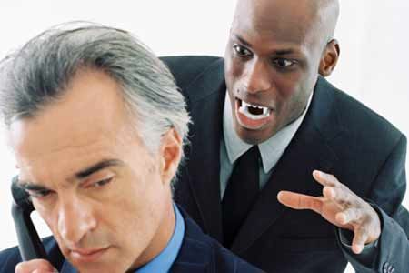
Pleasing Manners

Slide 7
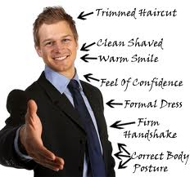
Smart Dress

Slide 8
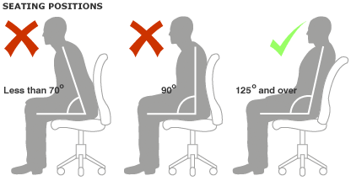
Standing and Sitting Position

Slide 9
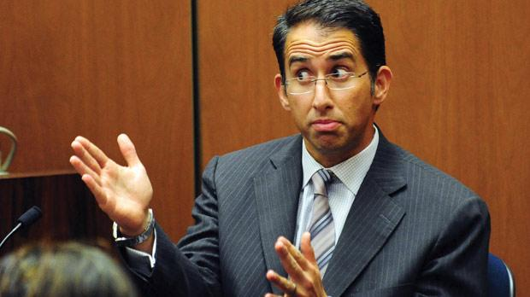
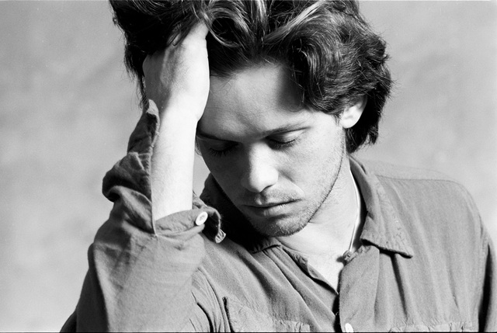
Avoid involuntary action

Slide 10
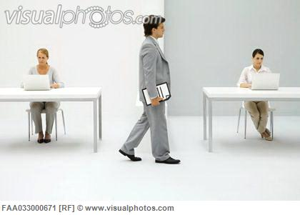
Walking towards Panel

Slide 11
All these known as 30 Seconds Capsules Need 300 days of training and preparation

Slide 12
Women's Interview Attire
Solid color, conservative suit
Coordinated blouse
Moderate shoes
Limited jewelry
Neat, professional hairstyle
Tan or light hosiery
Sparse make-up & perfume
Manicured nails

Slide 13
Men's Interview Attire
Solid color, conservative suit
White long sleeve shirt
Conservative tie
Dark socks, professional shoes
Very limited jewelry
Neat, professional hairstyle
Go easy on the aftershave
Neatly trimmed nails
Portfolio or briefcase

Slide 14
DON’TS
Don't Prepare
Dress Inappropriately
Poor Communication Skills
Too Much Communication
Talk Too Much
Don't Talk Enough
Fuzzy (unclear) Facts
Give the Wrong Answer
Badmouthing Past Employers
Forget to Follow Up

Slide 15
Not to Ask the Employer...
Can I do this job from home?
What does your company do?
When can I take time off for vacation?
Did I get the job?
What is the salary for this position?
How many hours will I be expected to work each work? Will I need to work on weekends?
How long would I have to wait to get promoted?
What type of health insurance does this company offer?

